Slide 1
Search Result Interface
Hongning Wang
CS@UVa

Slide 2
Abstraction of search engine architecture
Indexed corpus
Crawler
Ranking procedure
Feedback
Evaluation
Doc Analyzer
(Query)
Query Rep
User
Doc Representation
Ranker
Indexer
results
Index

Slide 3
Search interface
Evolution of Google’s result interface
http://www.seosmarty.com/google-interface-evolution/

Slide 4
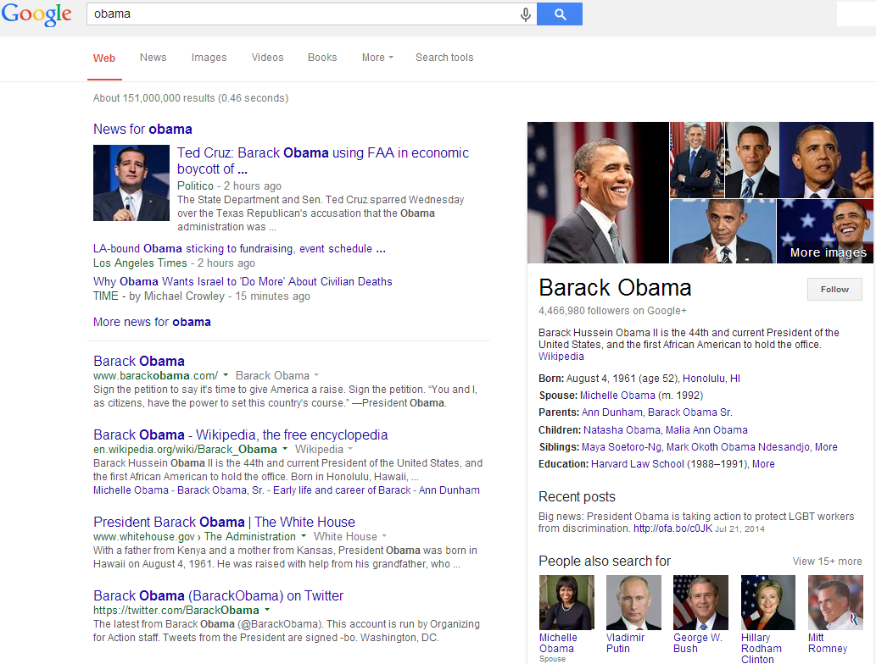
Google’s

Slide 5
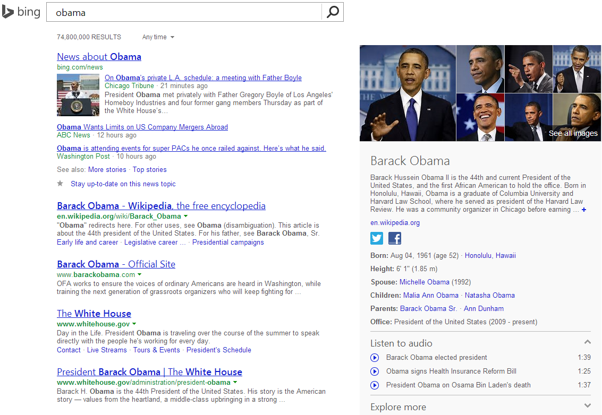
Bing’s

Slide 6
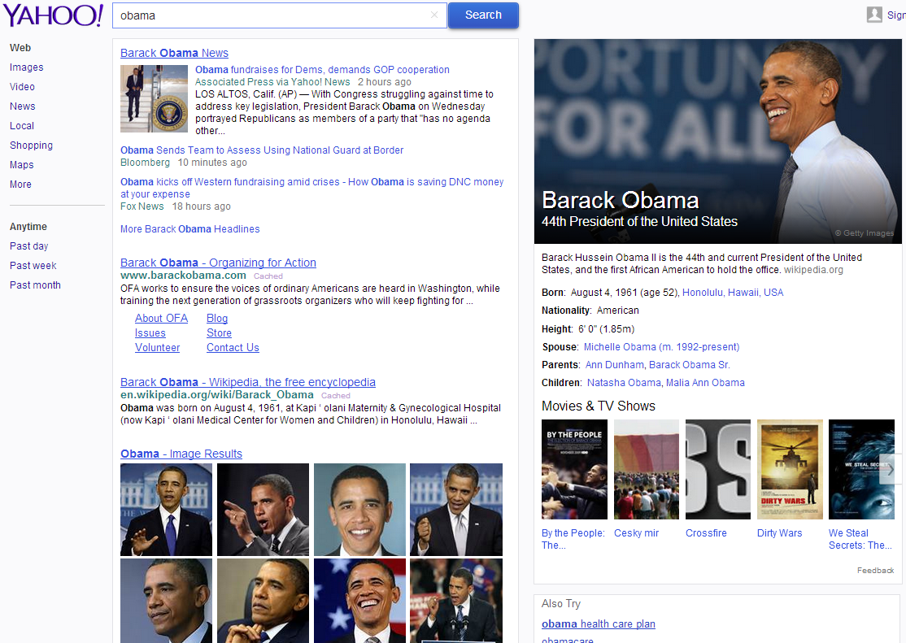
Yahoo’s

Slide 7
Recap: Index compression
Observation of posting files
Instead of storing docID in posting, we store gap between docIDs, since they are ordered
Zipf’s law again:
The more frequent a word is, the smaller the gaps are
The less frequent a word is, the shorter the posting list is
Heavily biased distribution gives us great opportunity of compression!
Information theory: entropy measures compression difficulty.

Slide 8

Recap: Search within inverted index
Example: AND operation
scan the postings
Term1
2
4
8
16
32
64
128
Term2
1
2
3
5
8
13
21
34
Time complexity: $O(\left|L_{1}\right|+|L_{2}|)$
Trick for speed-up: when performing multi-way join, starts from lowest frequency term to highest frequency ones

Slide 9
Recap: Phrase query
Generalized postings matching
Equality condition check with requirement of position pattern between two query terms
e.g., T2.pos-T1.pos = 1 (T1 must be immediately before T2 in any matched document)
Proximity query: |T2.pos-T1.pos| ≤ k
scan the postings
Term1
2
4
8
16
32
64
128
Term2
1
2
3
5
8
13
21
34

Slide 10
What are there
It has been there since the search engine was born
A list of links to the search result page
Text summarization of the retrieved document
Title + text snippet
Search suggestions
Related search
Spelling correction
Query auto-completion
Vertical search
Image, shopping, news
Knowledge graph
As a result of NLP techniques
Simple Q&A

Slide 11
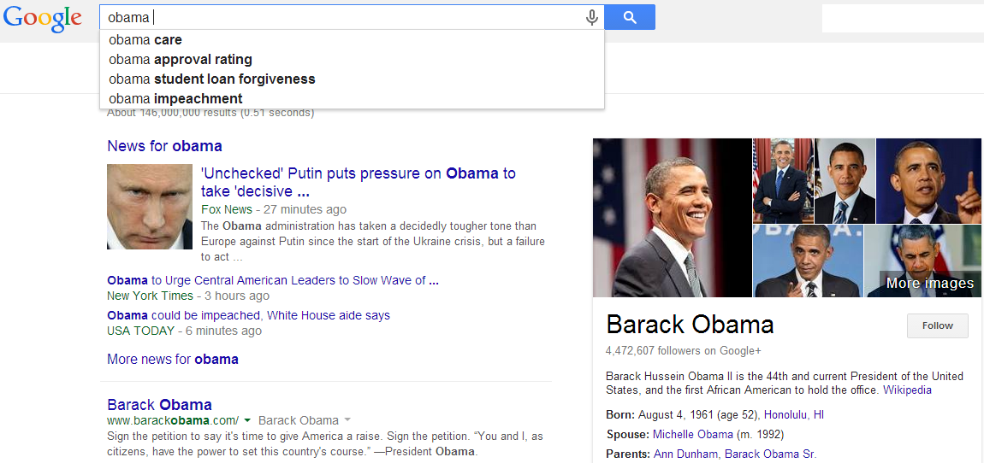
Query auto-completion

Slide 12
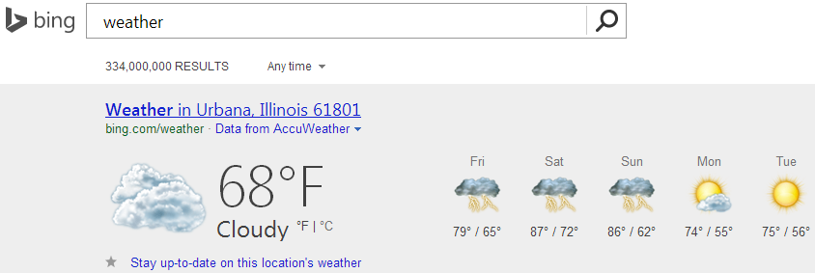
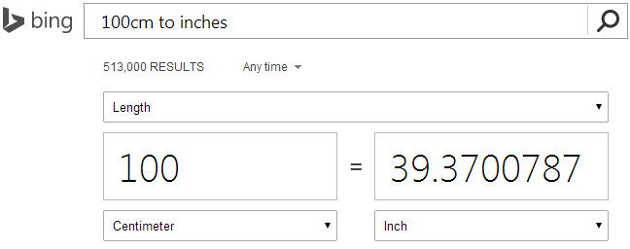
Direct answers
Advanced version of “I’m feeling lucky”

Slide 13
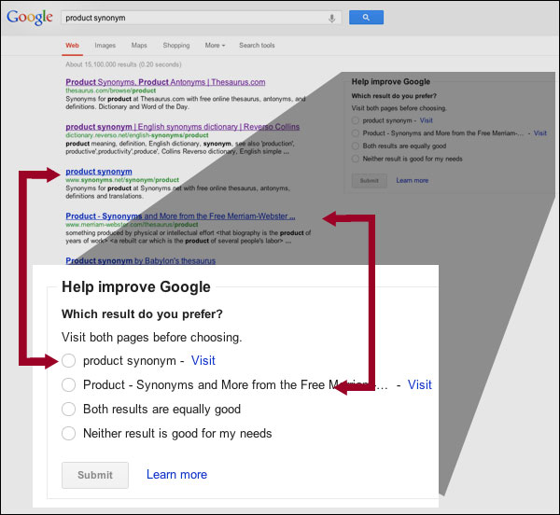
Experimental features
Search result feedback

Slide 14
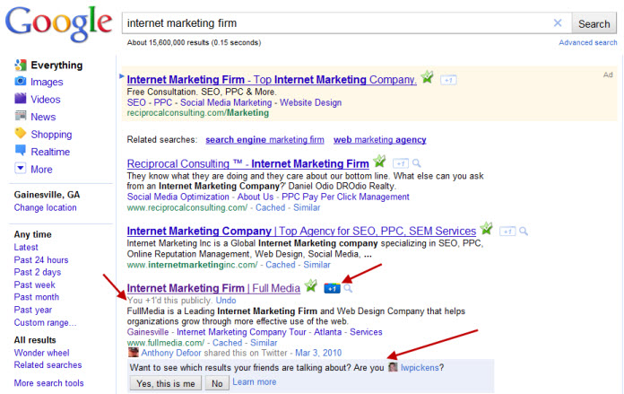
Experimental features
Collaborative ranking

Slide 15
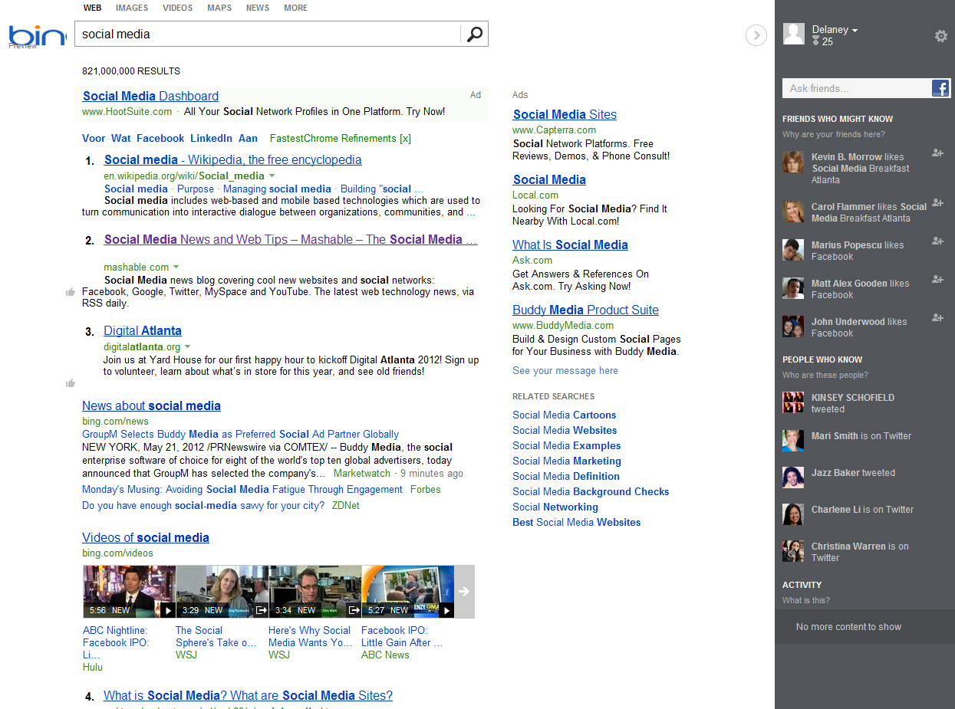
Experimental features
Social panel

Slide 16
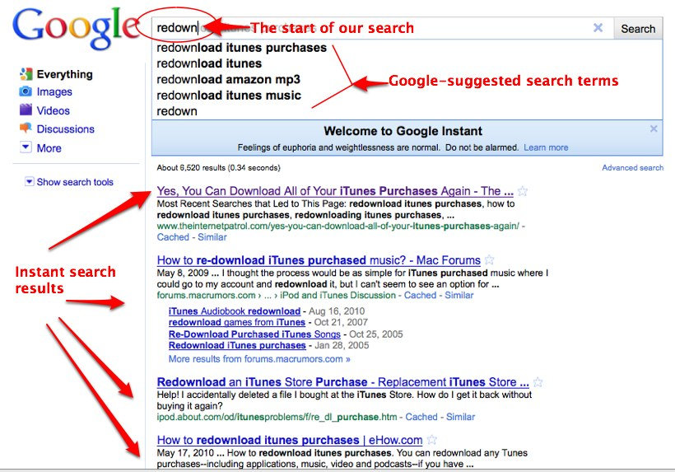
Instant search

Slide 17
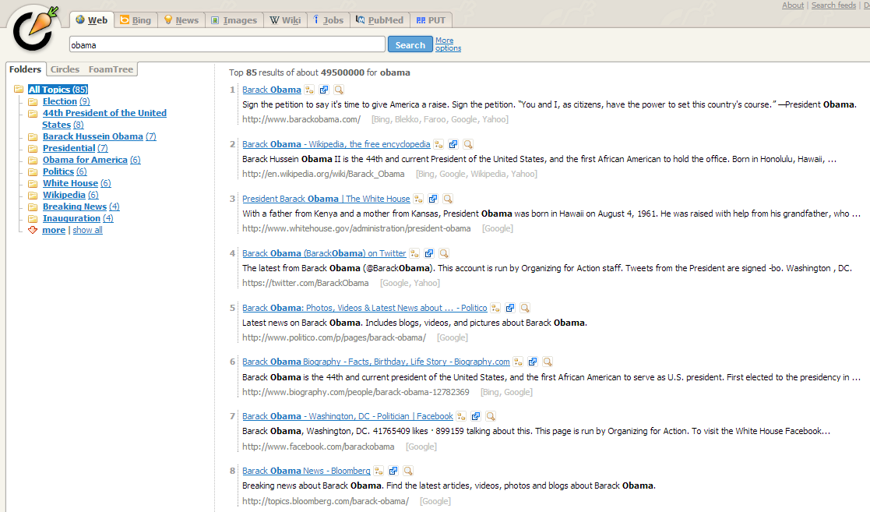
Carrot2’s folder display
Organized results

Slide 18
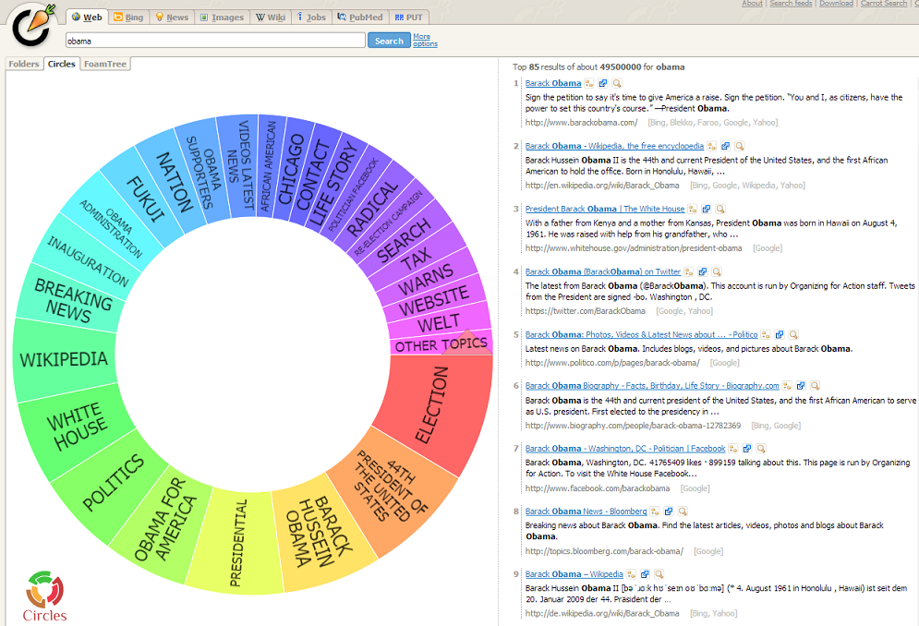
Carrot2’s circle display

Slide 19
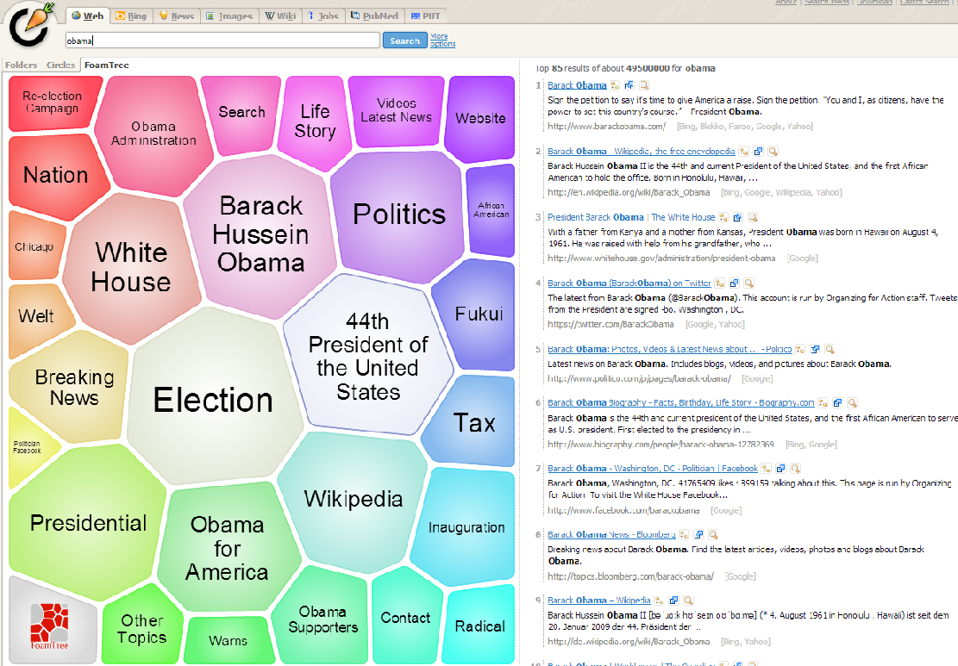
Carrot2’s foam tree display

Slide 20
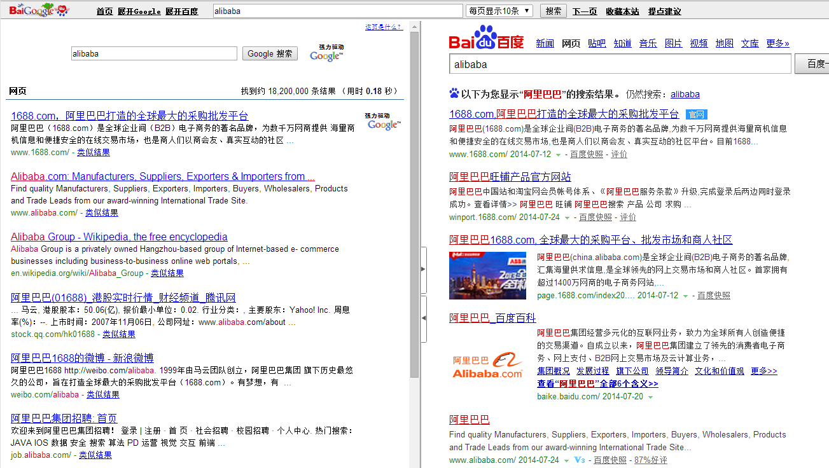
BaiGoogledu
Meta search engine

Slide 21
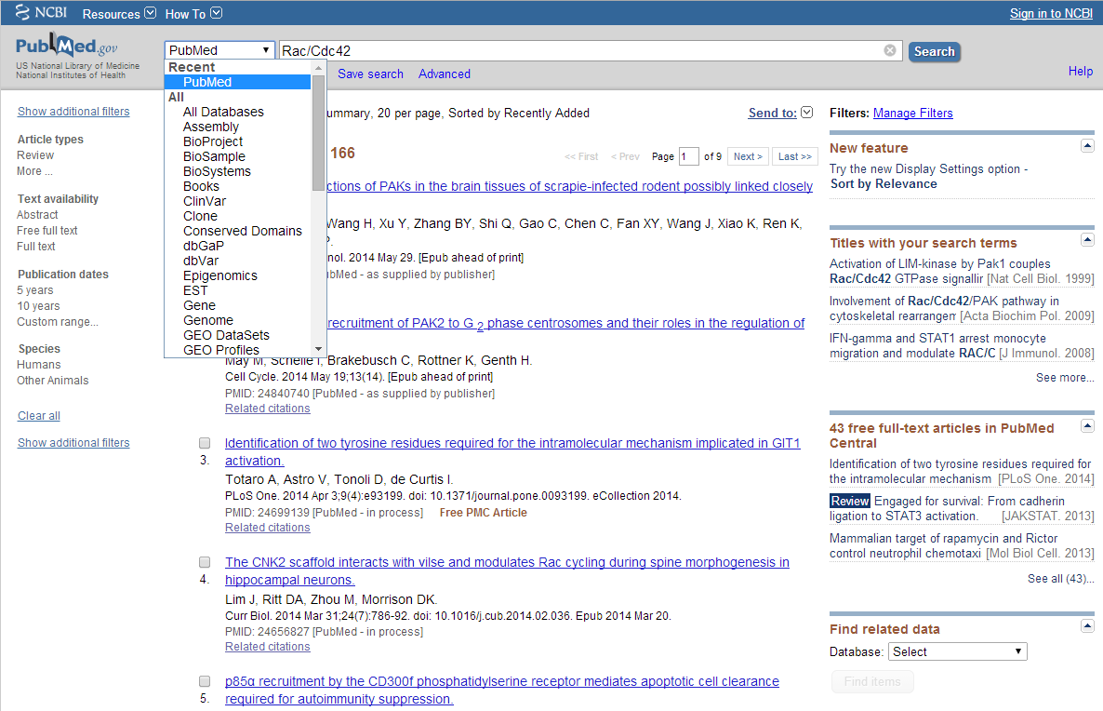
PubMed

Slide 22
Considerations in result display
Relevance
Order the results by relevance
Diversity
Maximize the topical coverage of the displayed results
Navigation
Help users easily explore the related search space
Query suggestion
Search by example

Slide 23
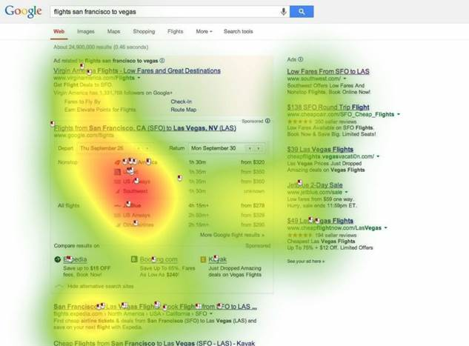
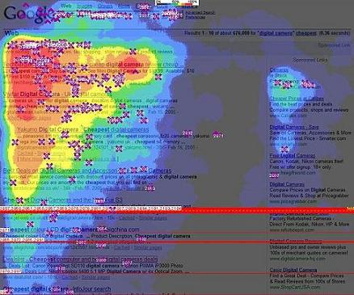
Research progress
In Human-Computer Interaction
Eye/Mouse tracking study of interaction between users and search result page
Psychological study of user behaviors
Facet categories, text summaries, colors, positions
In Information Retrieval
Less attention has been put in this aspect in history
Attracting more and more research focus now

Slide 24
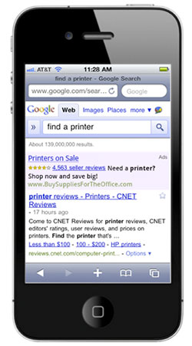
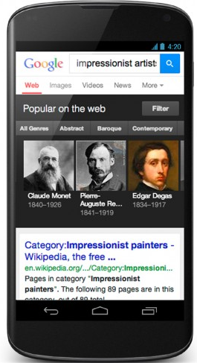
Search result display in mobile device
Unique characteristics of mobile device
Small screen size, limited bandwidth, input, data-access and computation power
Multi-touch screen
Rich search context
Opportunities?

Slide 25
What you should know
General considerations in search result display
Challenges and opportunities in mobile device search result display

